Slide 1
Uninstructed Robot
Daewon Choi
Robots with Humans Laboratory
Notes:
- 안녕하세요 오늘은 CogVLM Visual Expert for language models에 대해서 발표 하겠습니다.
- 현재 어디 게제된 곳은 없습니다.

Slide 2
Index
Structure
Prompt for selection of subtask
Framework
Object Detection Result Of Multi Frame ➔ Recognize as 1 Object
Subtask
Notes:
- 이 순서대로 발표 하겠습니다.

Slide 3
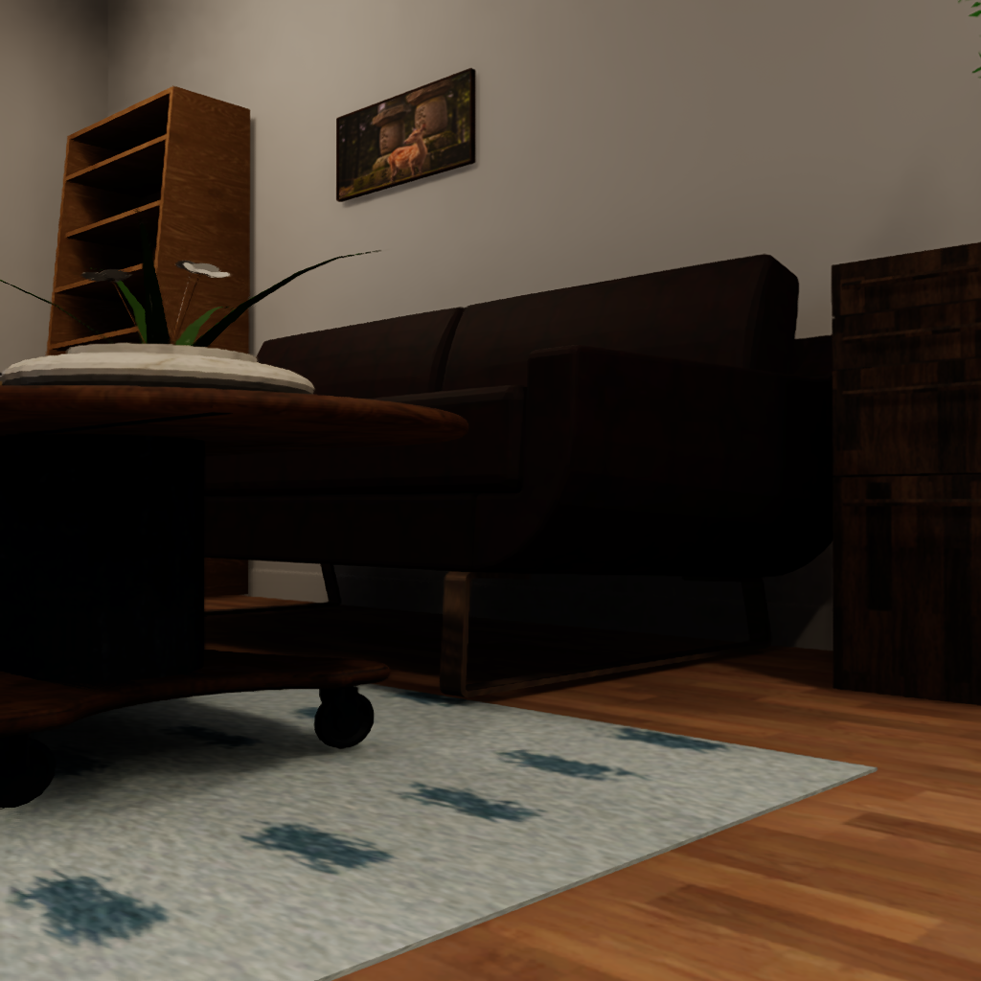
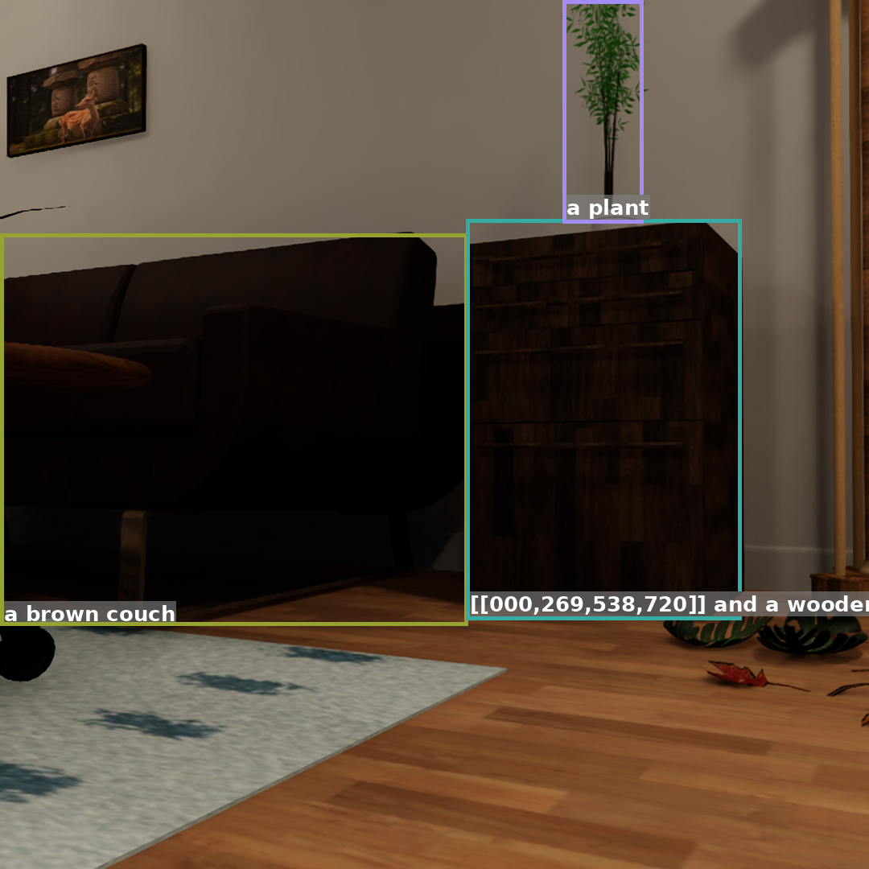
Structure
Object
Name
+
Box Info
CogVLM
(groundiong-v1.1)
By Frame
Object Detection
Select subtask through
object information and description of object
Object
Name
+
Box Info
Prompt for description
Description
by
object
CogVLM
(chat-v1.1)
By Object
Prompt for Selection of subtask
Subtask
LLM

Slide 4
Prompt for selection of Subtask
The book is lying open on the floor with its pages facing upwards. It appears to be in a relaxed or discarded state, possibly after being read or set aside.
Please refer to the above description of book in bounding box [0.51, 0.688, 0.852, 0.771] and select what you need to do currently.
Option:[Preserve current status’, ‘Organize', 'sweeping', 'mopping', 'Putting in the trash can']
Description of object
Command
Option

Slide 5
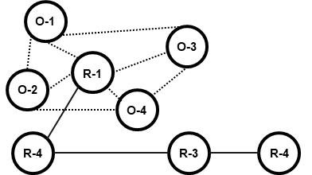
Framework
Topological Map
(All Environment)
Topological Map
(With Subtask)
?
O-1
O-3
O-1
O-2
R-1
O-3
O-4
O-2
R-1
Object
Name
+
Box Info
Object
Name
+
Box Info
O-4
Detection
Object
Name
+
Box Info
R-4
R-3
R-4
R-4
R-3
R-4
By Frame
Object
Name
+
Box Info
Object
Name
+
Box Info
Object
Name
+
Box Info
Object
Name
+
Box Info
VLM
(for Description)
Object
Description
LLM
(for subtask)
Subtask
By
Object
Classification Subtask w/LLM
Sameness
Reduce number of questions asked to LLM
Topological Map
(Specific part)
⬅
O-1
Comparison
(Rule or D/L)
Object
Name
+
Box Info
Object
Name
+
Box Info
Detection
Object
Name
+
Box Info
O-3
Difference
Classify Subtask
O-2
By Frame
O-4

Slide 6
Framework
Object 별 관계에 따른 Subtask 가 다를 것이다.
O-1
O-3
O-1
O-3
R-1
O-3
O-1
R-1
Personalized Net
O-2
R-1
O-4
O-2
O-4
O-2
O-4
Sameness
Topological Map
(Specific part)
Comparison
(Rule or D/L)
High Difference
Object
Name
+
Box Info
O-1
LLM
Object
Name
+
Box Info
Detection
Object
Name
+
Box Info
O-3
O-2
Low
Difference
By Frame
O-4
Personalized
Net

Slide 7
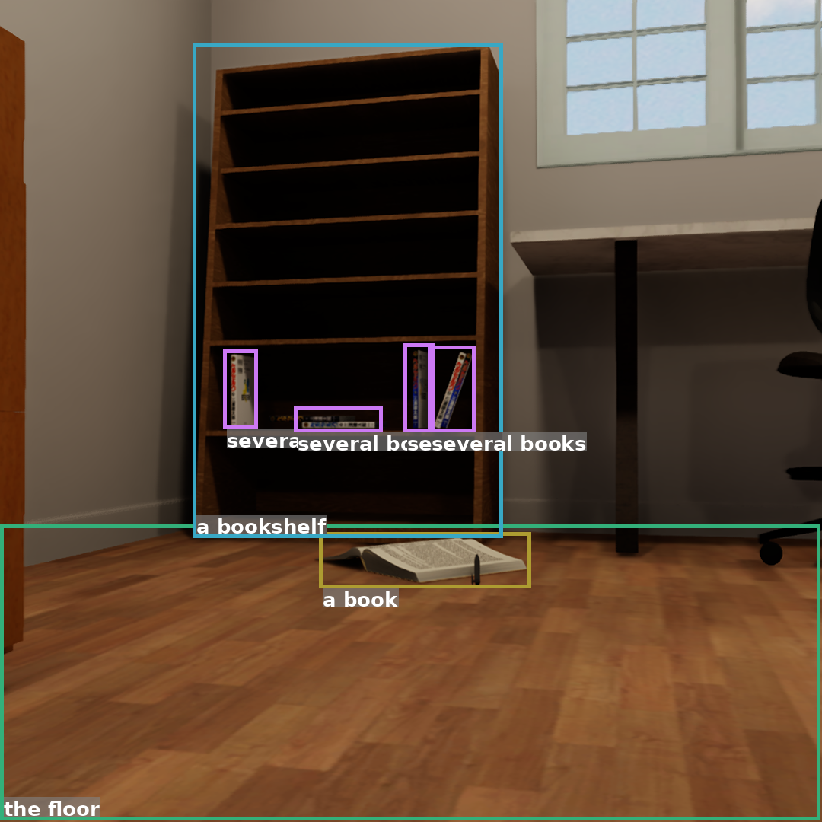
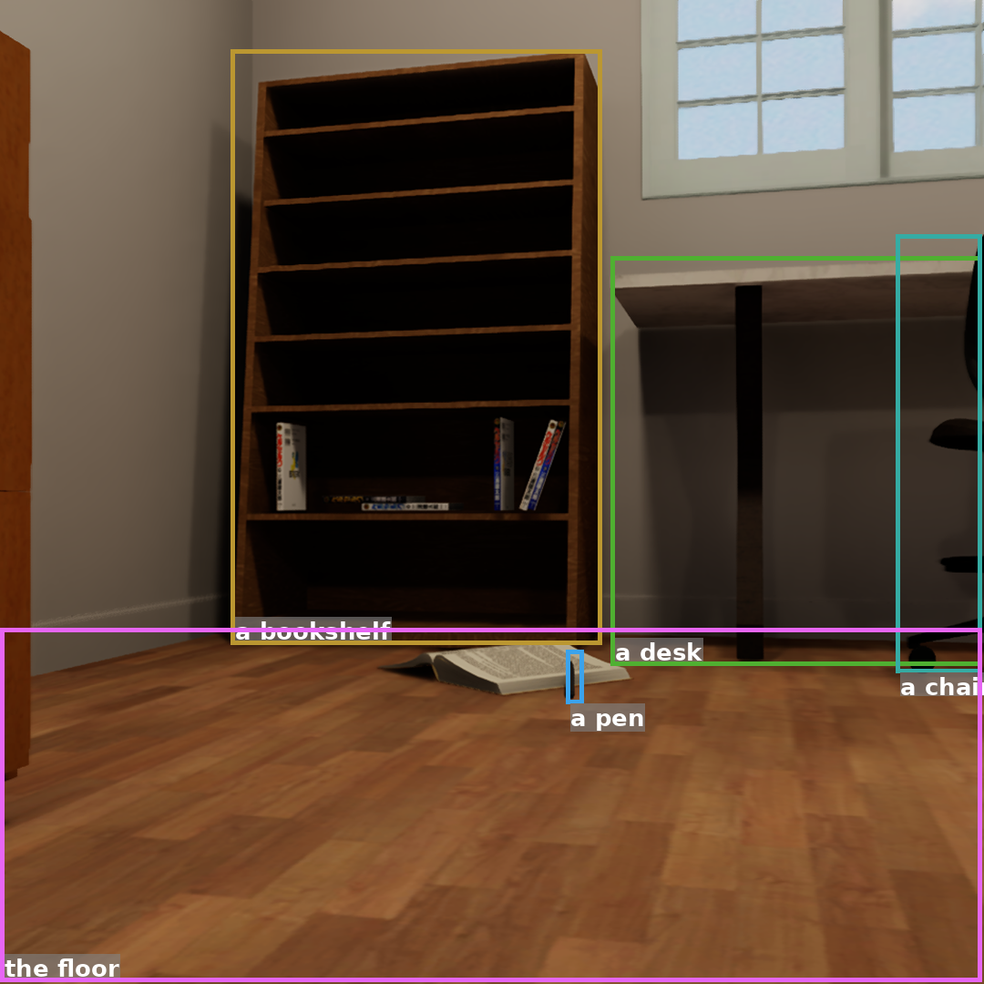
Object Detection Result Of Multi Frame
Object with subtask selected
Total object information
Box
info
Previous Frame
Box
info
Compare
Current Frame

Slide 8
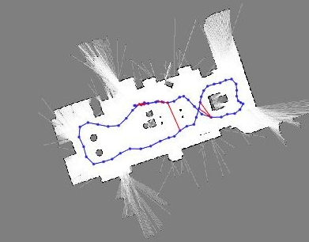
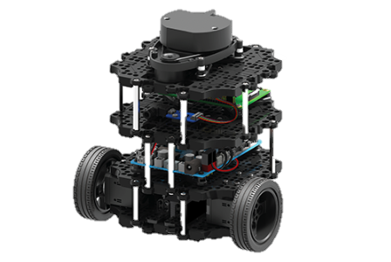
Object Detection Result Of Multi Frame
- Class name
- average_depth
object position on map
- Position of robot

Slide 9
Object Detection Result Of Multi Frame
object position on map
S
D
Class name
Other class
S
D
Same class
Nothing

Slide 10
Subtask
Bream(태워서 청소하다)
Brush
Wipe up
Disinfect(소독하다)
Dry clean
Dust
Pipe-clay
cleaning
preen
Sanitize(살균하다)
Scavenge
Sweep
Vacuum
Dishwashing
Wash
Laundering
Wash up

Slide 11
Thank you
Q & A

Slide 12

Object Detection Result Of Multi Frame
Previous Frame
Current Frame

Slide 13
Framework
Topological Map
(All Environment)
Topological Map
(With Subtask)
O-1
?
O-3
O-1
O-2
R-1
O-3
O-4
O-2
R-1
Object
Name
+
Box Info
Object
Name
+
Box Info
O-4
Detection
Object
Name
+
Box Info
R-4
R-3
R-4
R-4
R-3
R-4
Object
Name
+
Box Info
Object
Name
+
Box Info
Object
Name
+
Box Info
Object
Name
+
Box Info
VLM
(for Description)
Object
Description
VLM
(for subtask)
Subtask
By
Object
Classification Subtask
Sameness
Reduce number of questions asked to LLM
Topological Map
(Specific part)
⬅
Object
Name
+
Box Info
O-1
comparison
Object
Name
+
Box Info
Detection
Object
Name
+
Box Info
O-3
Difference
Classify Subtask
O-2
By Frame
O-4

Slide 14
O-1
O-3
O-2
R-1
O-4
R-4
R-3
R-4

